Slide 1

IMAGE DEBLURRING USING DEEP LEARNING
GUIDED BY:
Mr. ANOOP K JOHNSON
Dept. of ECE, MBCET
TEAM MEMBERS:
BHADRA MAYA ANILKUMAR
G PREETHI RAVISANKAR
GOURI A V
GOWRI H BHAGAVATHI
Dept of ECE, MBCET

Slide 2

OBJECTIVE
Image Deblurring Using Deep Learning
PROBLEM STATEMENT : “Deblurring of blurry images from various camera footages with 70 –100 % accuracy.”
CAUSES :
Motion Blur: Blur due to movement of objects
Improper holding of the camera
Dirty lens
Wrong focusing
Depth of field
Dept of ECE, MBCET

Slide 3
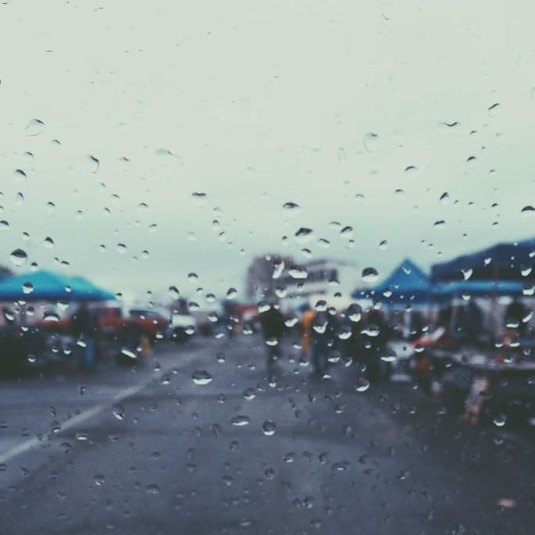
INTRODUCTION
Image Deblurring Using Deep Learning
Image Processing is a signal processing method in which input is an image and output is an enhanced image.
Image Deblurring is an image processing method that removes distortion from a blurry image.
Blurry images have long been a major problem in computer vision and image processing.
Applications in various fields like photography, medical imaging, forensic science, and astronomy.
Dept of ECE, MBCET

Slide 4

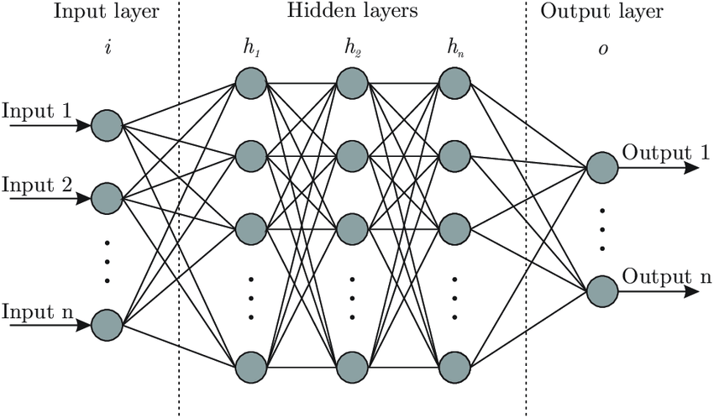
BACKGROUND
Image Deblurring Using Deep Learning
Deep Learning: Subset of Machine Learning in AI that imitates the working of human brain.
DL has networks capable of learning unsupervised.
CNN: Capable of extracting features of input images through convolution using filters; weights are automatically learned during training.
Dept of ECE, MBCET

Slide 5

Image Deblurring Using Deep Learning
LITERATURE REVIEW- 1
J. Liu, W. Sun and M. Li, "Recurrent Conditional Generative Adversarial Network for Image Deblurring," in IEEE Access, vol. 7, pp. 6186-6193, 2019.
A recurrent generative adversarial network is used to reconstruct high definition images.
A scale recurrent generator extracts spatio-temporal features and reconstruct sharp images in a coarse-to-fine form.
The discriminator takes blurry images as conditions, structural information of which assists in distinguishing real sharp images.
A progressive loss function is used to enhance the gradients in back propagation.
Dept of ECE, MBCET

Slide 6
Image Deblurring Using Deep Learning
LITERATURE REVIEW- 2
C. Min, G. Wen, B. Li and F. Fan, "Blind Deblurring via a Novel Recursive Deep CNN Improved by Wavelet Transform", IEEE Access, vol. 6, pp. 69242-69252, 2018.
Wavelet transform is an effective denoising method related to regularized inversion.
It is utilized to decompose and extract the low- and high-frequency information of the blurred image, which is taken as the first step.
When the process highlights the approximate portion of the image feature, the blurry image will be smoothed so that the image is distorted.
Dept of ECE,MBCET
Dept of ECE, MBCET

Slide 7
Image Deblurring Using Deep Learning
LITERATURE REVIEW- 3
O.Kupyn, V.Budzan, M.Mykhailych, D. Mishkin and J.Matas, "DeblurGAN: Blind Motion Deblurring Using Conditional Adversarial Networks,"IEEE/CVF, UT, 2018, pp.8183-8192.
Contributions are in three fold:
Loss and architecture which obtain desirable results.
A method based on random trajectories for generating dataset.
A novel dataset and method for evaluation of algorithms based on how they improve object detection results.
Dept of ECE, MBCET

Slide 8
Image Deblurring Using Deep Learning
LITERATURE REVIEW- 4
Scale-Recurrent Network for Deep Image Deblurring Xin Tao, Hongyun Gao, Xiaoyong Shen, Jue Wang, Jiaya Jia; The IEEE CVPR, 2018, pp. 8174-8182.
In this paper, a scale recurrent network has been proposed for the deblurring task.
Compared with deep multi-scale convolutional for dynamic scene deblurring; it has a simpler network structure, a smaller number of parameters and is easier to train.
Dept of ECE, MBCET

Slide 9
LITERATURE REVIEW- 5
Image Deblurring Using Deep Learning
A multi-scale convolutional neural network is proposed that restores sharp images in an end-to-end manner.
This method achieves the state-of-the-art performance in dynamic scene deblurring not only qualitatively, but also quantitatively.
S. Nah, T. H. Kim and K. M. Lee, "Deep Multi-scale Convolutional Neural Network for Dynamic Scene Deblurring," 2017 IEEE Conference on CVPR, Honolulu, HI, 2017, pp. 257-265.
Dept of ECE, MBCET

Slide 10
Image Deblurring Using Deep Learning
LITERATURE REVIEW- 6
F. Albluwi, V. A. Krylov and R. Dahyot, "Image Deblurring and Super-Resolution Using Deep Convolutional Neural Networks," 2018 IEEE MLSP, Aalborg, 2018, pp. 1-6.
Simultaneously addresses deblurring and super-resolution from blurred low resolution images.
Proves its superiority via experimenting both when the levels of blur are known and unknown ~ Deblurring Super-Resolution Convolutional Neural Network (DBSRCNN).
Dept of ECE, MBCET

Slide 11

GENERATIVE ADVERSIAL NETWORK (GAN)
Image Deblurring Using Deep Learning
Ability to preserve texture details in images.
Create solutions that are close to the real image and look perceptually convincing.
In Generative Adversial Network, two networks train against each other.
Generator misleads the discriminator by creating compelling fake inputs.
Discriminator tells if an input is real or artificial.
11
Dept of ECE, MBCET

Slide 12
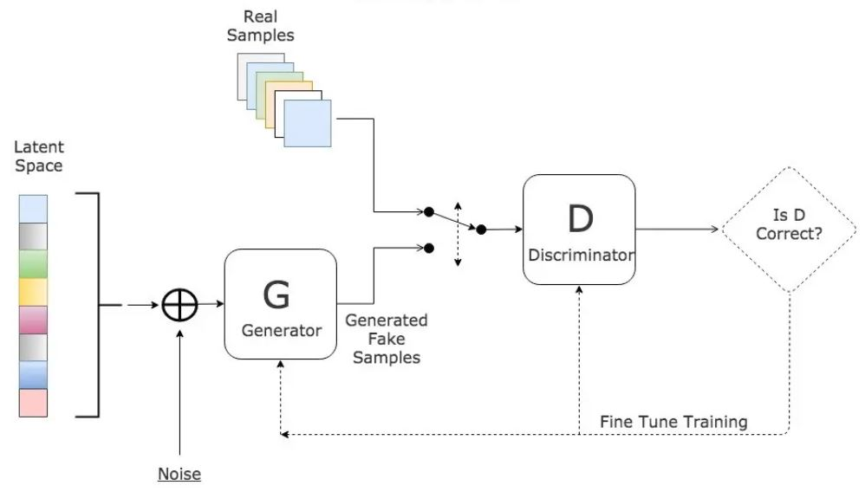
Image Deblurring Using Deep Learning
GAN
Dept of ECE, MBCET

Slide 13
BASIC BLOCK DIAGRAM
Image Deblurring Using Deep Learning
BLURRY IMAGE
WRC-GAN
DEBLURRED IMAGE
Wavelet Recurrent Conditional GAN Network
Fig: Image Deblurring using GAN
Dept of ECE, MBCET

Slide 14
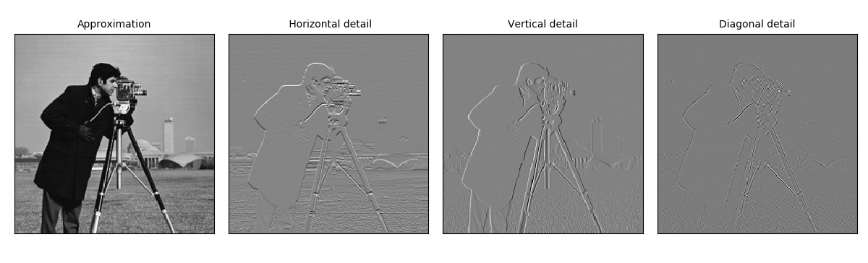
Image Deblurring Using Deep Learning
SINGLE LEVEL 2D
DISCRETE WAVELET TRANSFORM
(HAAR)
HL
VL
DL
Dept of ECE, MBCET

Slide 15
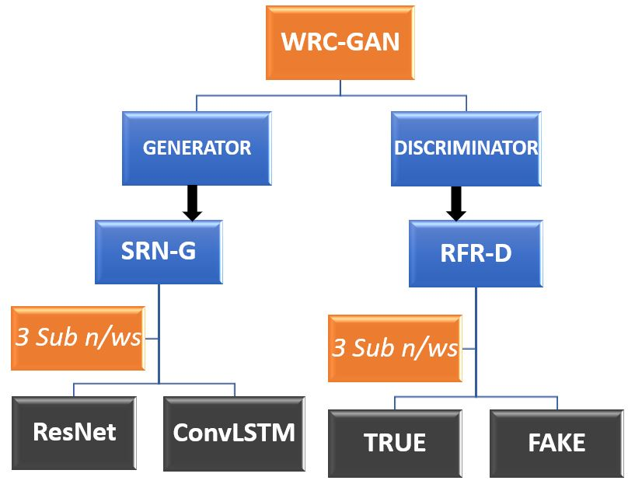
Image Deblurring Using Deep Learning
BASIC BLOCK DIAGRAM: WRC-GAN
Dept of ECE, MBCET

Slide 16
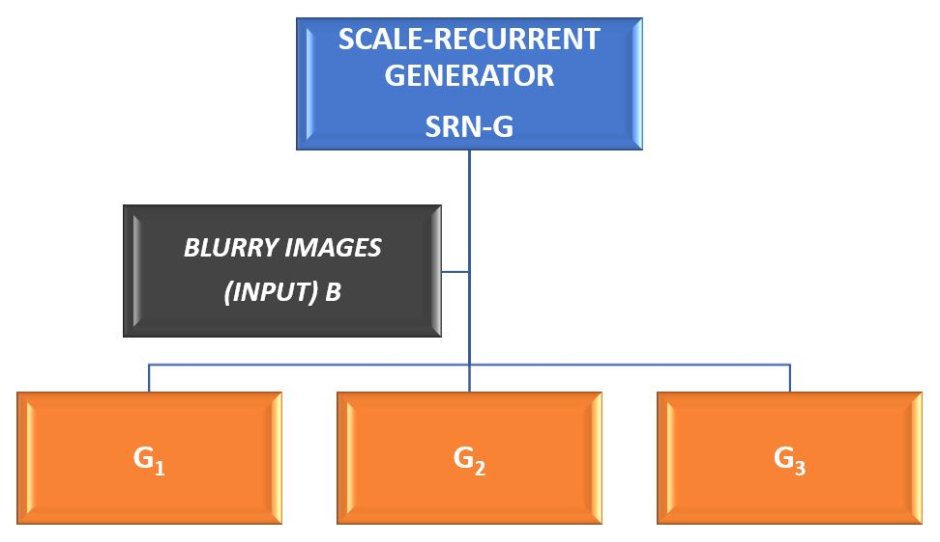
Image Deblurring Using Deep Learning
BLOCK DIAGRAM: GENERATOR
Dept of ECE, MBCET

Slide 17
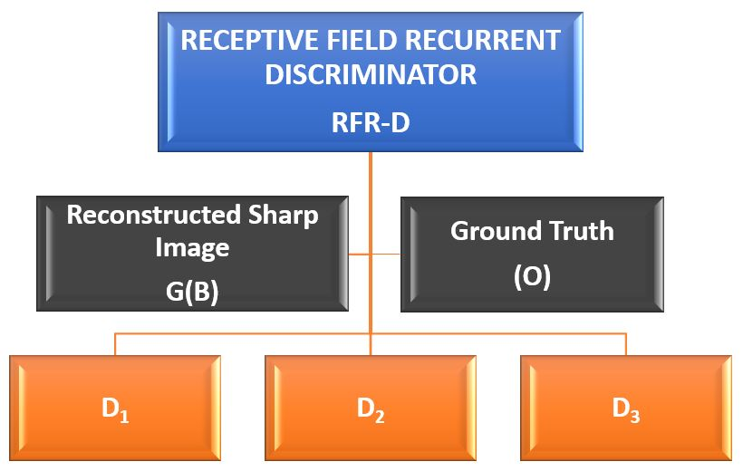
Image Deblurring Using Deep Learning
BLOCK DIAGRAM: DISCRIMINATOR
R(S)
Dept of ECE, MBCET

Slide 18
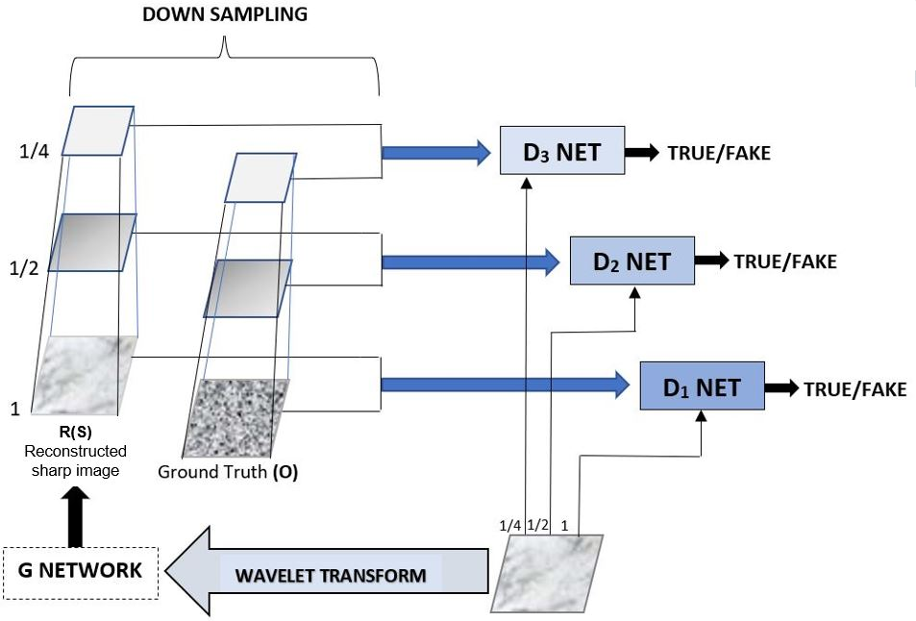
Image Deblurring Using Deep Learning
BLOCK DIAGRAM : WRC-GAN
Dept of ECE, MBCET

Slide 19

Image Deblurring Using Deep Learning
DATASET
GOPRO
The GoPro dataset consists of 2,103 image pairs for training & 11 sequences with 1, 111 image pairs for testing.
It blur images by integrating sharp images over time.
Generates blurred images through averaging adjacent short-exposure frames captured by a high-speed video camera.
This dataset can imitate the image blur type in natural scenes.
Images are captured from various scenes and are at a resolution of 1280 x 720.
21
Dept of ECE, MBCET

Slide 20


Image Deblurring Using Deep Learning
T
O
O
L
S
&
S
O
F
T
W
A
R
E
U
S
E
D
ANACONDA
TENSORFLOW
KERAS
PYTHON
GRAPHICS PROCESSING UNIT
GPU
Dept of ECE, MBCET
22

Slide 21
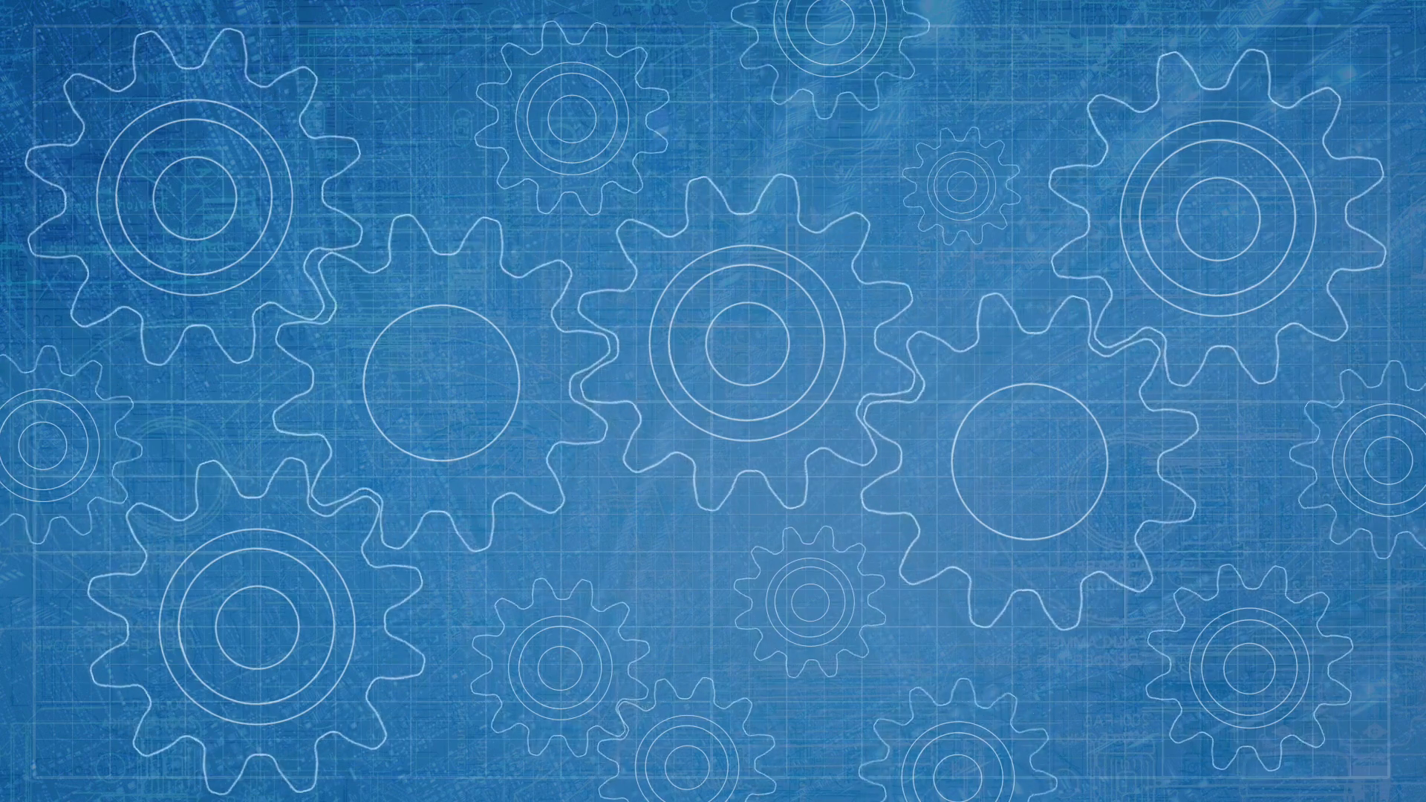
Image Deblurring Using Deep Learning
TRAINING
WRC GAN- is trained for 4 epochs.
Learning rate polynomial decayed from 10^-4.
Expected training of minibatch size is set to 16.
Adam Optimizer is used with Hyper-parameters ꞵ1= 0.9,
ꞵ2 = 0.999, ɛ = 10^-8.
Implemented with Keras on TensorFlow framework in GPU.
23
Dept of ECE, MBCET

Slide 22
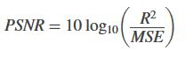
Image Deblurring Using Deep Learning
PERFORMANCE EVALUATION PARAMETER
PSNR
Peak Signal to Noise Ratio: It is the ratio of maximum possible power of original image to that of corrupting noise.
This measure is used to determine the restoration quality of the signal.
Large value of PSNR signifies better Restoration.
Major Feature: A minute spatial shift of an image leads to large numerical distortion but no visible distortion.
where R is the maximum fluctuation in the input image data type.
Dept of ECE, MBCET

Slide 23
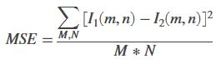
PERFORMANCE EVALUATION PARAMETER (Contd.)
MSE
Mean Squared Error : It is the sum of the squared distances between the target variable and predicted values.
It is used to calculate the error by squaring the + or – errors with itself.
It is more accurate when compared to mean error computation.
MSE values ranges from 0 to ∞.
where M & N are rows and columns of the image.

Slide 24
WORK PLAN
Image Deblurring Using Deep Learning
SL NO. | MONTH PROJECT PHASE | AUG | SEP | OCT | NOV | DEC | JAN | FEB | MAR
1. | Problem Identification
2. | Literature Review
3. | Phase 1: Formulation of Methodology
4. | Phase 2: Setting up of GPU & Software
5. | Phase 3: Code Implementation
6. | Phase 4: Training and Testing
7. | Phase 5: Final Simulation and Demo
8. | Documentation of Project
Dept of ECE,MBCET

Slide 25

Image Deblurring Using Deep Learning
BUDGET!
Research works: Rs 500/-
Printing expenses: Rs 1500/-
Miscellaneous expenses: Rs 1000/-
Total expense: Rs 3000/-
Dept of ECE, MBCET

Slide 26
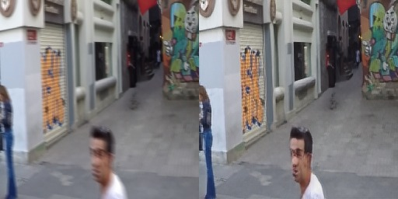
OUTPUT

Slide 27
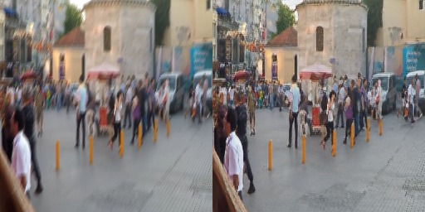
OUTPUT

Slide 28

Image Deblurring Using Deep Learning
WHAT’S NEXT ?
To include ConvLSTM blocks to the Generator network.
To train generator chained with discriminator.
To add discrete wavelet transform (DWT) to the model.
Dept of ECE, MBCET

Slide 29

REFERENCES
Image Deblurring Using Deep Learning
[1] S. Nah, T. H. Kim and K. M. Lee, "Deep Multi-scale Convolutional Neural Network for Dynamic Scene Deblurring," 2017 IEEE Conference on Computer Vision and Pattern Recognition (CVPR), Honolulu, HI, 2017, pp. 257-265.
[2] C. Min, G. Wen, B. Li and F. Fan, "Blind Deblurring via a Novel Recursive Deep CNN Improved by Wavelet Transform", IEEE Access, vol. 6, pp. 69242-69252, 2018. Available: 10.1109/access.2018.2880279.
[3] Scale-Recurrent Network for Deep Image Deblurring Xin Tao, Hongyun Gao, Xiaoyong Shen, Jue Wang, Jiaya Jia; The IEEE Conference on Computer Vision and Pattern Recognition (CVPR), 2018, pp. 8174-8182.
[4] F. Albluwi, V. A. Krylov and R. Dahyot, "Image Deblurring and Super-Resolution Using Deep Convolutional Neural Networks," 2018 IEEE 28th International Workshop on Machine Learning for Signal Processing (MLSP), Aalborg, 2018, pp. 1-6.
[5] Jinshan Pan, Jiangxin Dong, Jimmy Ren, Liang Lin, Jinhui Tang, and Ming-Hsuan Yang, "Spatially Variant Linear Representation Models for Joint Filtering", IEEE Conference on Computer Vision and Pattern Recognition (CVPR), 2019.
Dept of ECE, MBCET

Slide 30
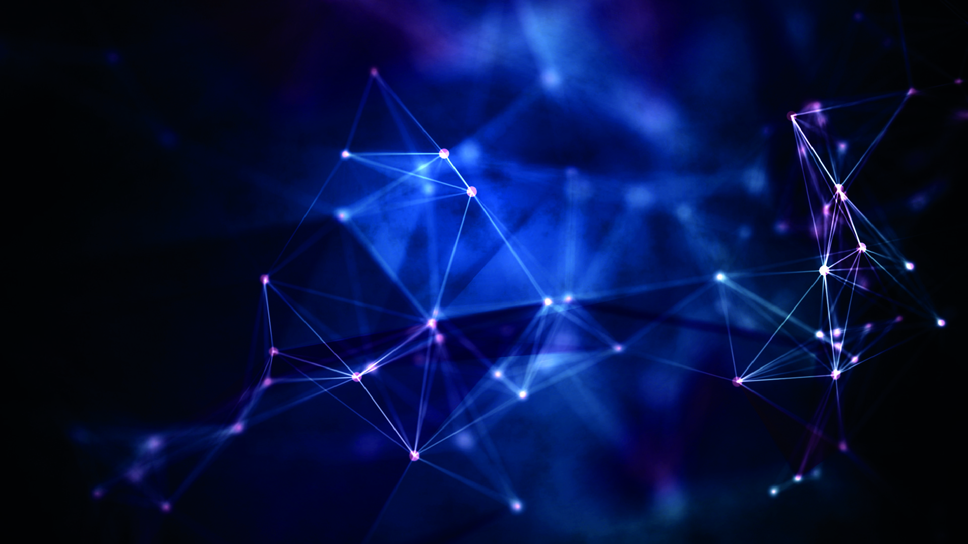
THANK YOU…

